Slide 1
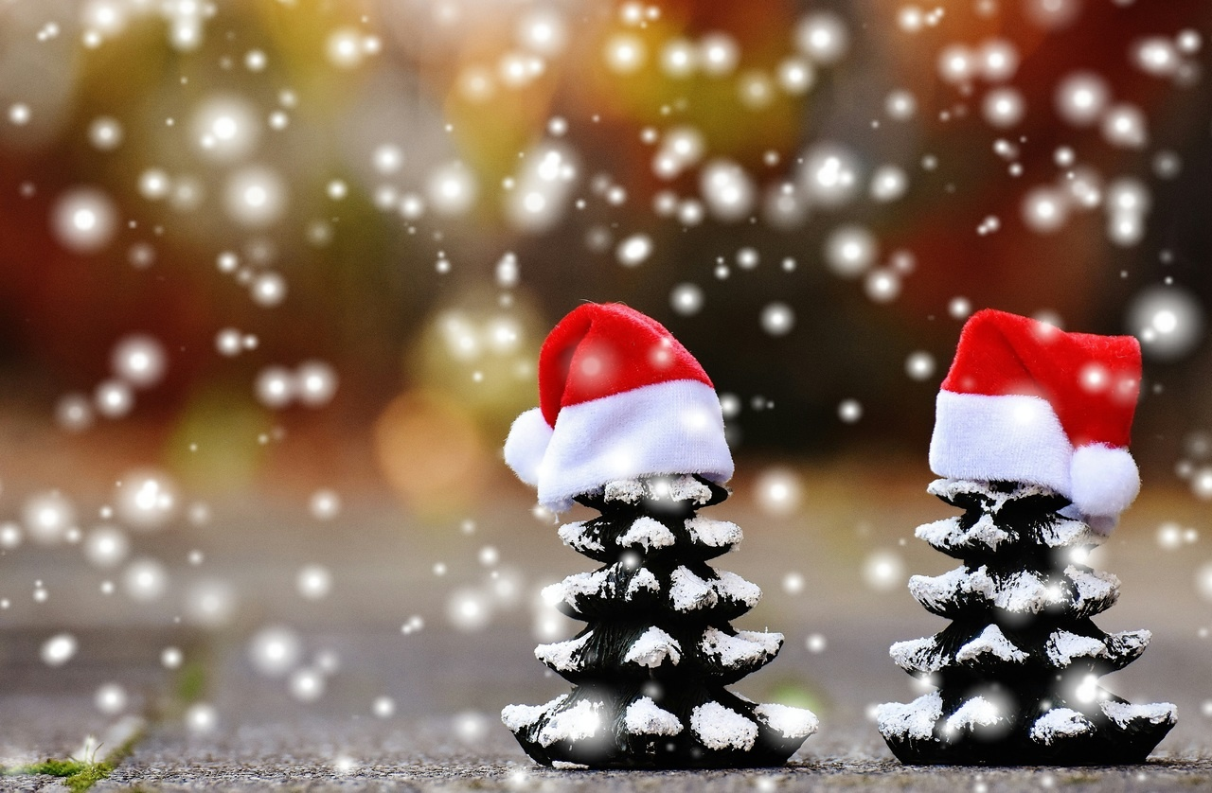
Christmas

Slide 2
Christmas table.
On the Christmas table there should be 12 dishes. This number is important, becouse it represents 12 apostles. There should be borscht with dumplings or fish soup, dumplings , fish, salads, cakes and dried fruit compote.

Slide 3
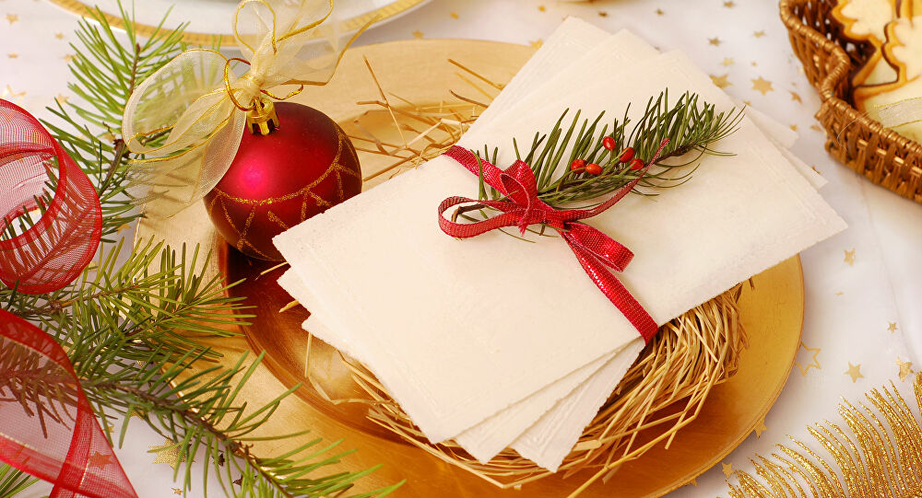
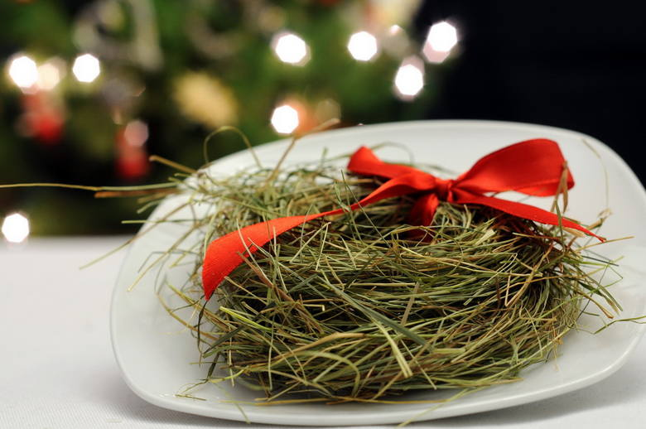
Hay under tablecloth and wafer.
Hay under the tablecloth represents a crib where Jezus was born.
Sharing the wafer represents reconciliation and forgiveness.

Slide 4
Looking for the first star.
Before Christmas dinner some people look for the first star. Only after finding the first star they eat Christmas dinner

Slide 5
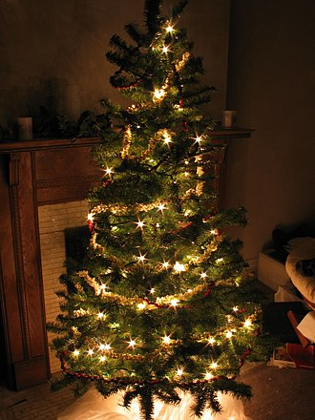
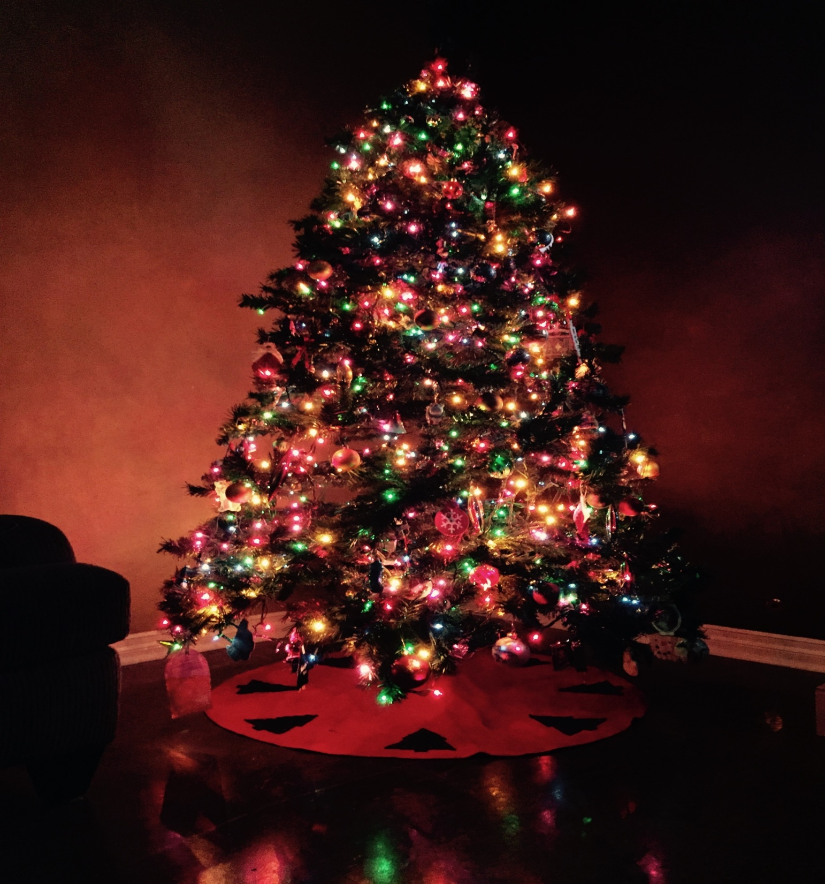
Decorate the Christmas tree.
Some people decorat the Christmas tree on Christmas Eve , other people decorat Christmas tree before Christmas

Slide 6
Open presents and sing carols.
Some people open presents in the morning, other people open presents after Christmas dinner and after singing carols.

Slide 7
Merry Christmas And Happy New Year !!!
By Ola

